Slide 1
PL/SQL Programming – InterMediate

Slide 2
Course Objectives
PL/SQL Fundamentals
Exception Handling
Cursors
Procedures
Functions

Slide 3
Session Objectives
Procedures
Functions

Slide 4
Procedures

Slide 5
Procedures
Understanding PL/SQL Procedures
A procedure is a PL/SQL subprogram used to perform an action. It
can be stored in the database as a schema object for repeated
execution.
  General Syntax for Creating procedures
CREATE [OR REPLACE]
PROCEDURE procedure_name[
(parameter1 mode1 datatype1, parameter2 mode2 datatype2...)]
IS | AS
[local declarations]
BEGIN
executable statements
[EXCEPTION
exception handlers]
END [name];

Slide 6
Procedures
  The CREATE clause enables the creation of Stand-alone procedures.
  The REPLACE option indicates,if the procedure already exists,it will dropped and replaced with the new version created by the statement.
  Procedure_name is the name of the stored procedure.
  Parameter is the name of the PL/SQL variable whose value is passed to or populated by the calling environment,based on the mode used.
  Mode is the Type of argument:
    IN (default)
    IN OUT
    OUT
  Datatype is the datatype of the arugment-can be SQL or PL/SQL data type.Can be %TYPE,%ROWTYPE,any scalar or composite data type.The size of the datatype of the parameters cannot be restricted.

Slide 7
Procedures
  Example of a simple PL/SQL procedure
CREATE OR REPLACE
PROCEDURE double ( original IN VARCHAR2,
new_string OUT VARCHAR2 )
AS
BEGIN
new_string := original || ' + ' || original;
EXCEPTION
WHEN VALUE_ERROR THEN
DBMS_OUTPUT.PUT_LINE('Output buffer not long enough.');
END double;
/

Slide 8
Procedures
Example
CREATE OR REPLACE
PROCEDURE proc1
(p_emp_id IN employees.employee_id%TYPE)
IS
PROCEDURE proc2
IS
BEGIN
…
END;
BEGIN
…
PROC2;
END;
Procedure ‘PROC2’ declared inside another procedure (PROC1)

Slide 9
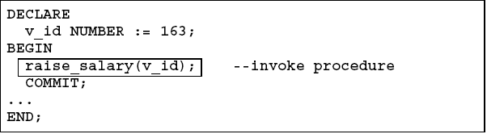
Procedures
Invoking Procedures
A procedure can be invoked in the following ways :
  i. Invoking a procedure from the SQL prom
  ii. Invoking a procedure from an anonymous PL/SQL block
EXECUTE [or EXEC] procedure_name;

Slide 10
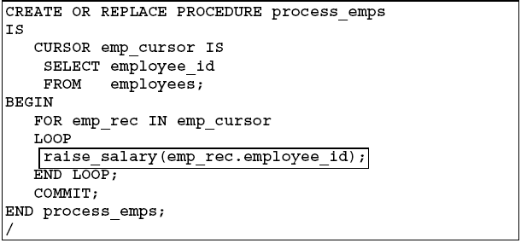
Procedures
ii. Invoking a procedure from another procedure

Slide 11
Procedures
Recompiling Procedures
Syntax
Example
Alter procedure <procedure_name> compile;
Alter procedure raise_salary compile;
Procedure altered.

Slide 12
Procedures Contd..
Removing Procedures
When a stored procedure is no longer required,it can be removed using the SQL DROP statement.
Syntax
Example
DROP PROCEDURE procedure_name
DROP PROCEDURE raise_salary;

Slide 13
Functions

Slide 14
Functions
Understanding PL/SQL Functions
A function is a PL/SQL subprogram used to perform an action.
It can be stored in the database as a schema object for repeated execution.
  General Syntax for Creating Functions
CREATE [OR REPLACE]
FUNCTION function_name[
(parameter1 mode1 datatype1, parameter2 mode2 datatype2...)]
RETURN DATATYPE
IS | AS
[local declarations]
BEGIN
executable statements
[EXCEPTION
exception handlers]
END [name];

Slide 15
Functions Contd..
  The CREATE clause enables the creation of Stand-alone functions.
  The REPLACE option indicates, if the function already exists, it will dropped and replaced with the new version created by the statement.
  Function_name is the name of the stored function.
  Parameter is the name of the PL/SQL variable whose value is passed to the function.
  Type of the parameter. Only IN parameter should be declared.
  Datatype is the data type of the arugment.
  RETURN data type must be the data type of the output by the function.The data type must not include a size specifiction.There must be atleast one RETURN statement

Slide 16
Functions Contd..
    Example of a simple PL/SQL function
CREATE OR REPLACE FUNCTION employer_details_func2
RETURN VARCHAR(20)
IS
emp_name VARCHAR(20)
BEGIN
SELECT first_name INTO emp_name FROM emp_tbl
WHERE empID = '100’;
RETURN emp_name;
END;
/

Slide 17
Functions Contd..
Executing Functions
A function can be executed in the following ways :
  Since a function returns a value we can assign it to a variable.
If ‘employee_name’ is of datatype varchar we can store the name of the
employee by assigning the return type of the function to it.
2. As a part of a SELECT statement
3. In PL/SQL Statements like,
This line displays the value returned by the function.
employee_name := employer_details_func;
SELECT employer_details_func FROM dual;
dbms_output.put_line(employer_details_func);

Slide 18
Functions Contd..
Invoking User-defined functions from SQL Expressions
  PL/SQL user-defined functions can be called from SQL expressions.
  To be invoked from a SQL statement, a stored PL/SQL function must be declared either at schema level or in a package specification.
  Advantages
  Permits calculations that are too complex ,awkward or unavailable in SQL.
  Increases data independence by processing complex data analysis in the Oracle server, rather than retrieving data into the application.
  Increases the efficiency of queries-Functions used in the WHERE clause of a query can filter data using criteria that must otherwise be evaluated by the application.

Slide 19
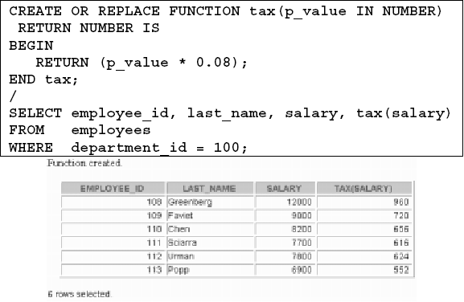
Functions Contd..
Example
The following user-defined function tax accepts a number as parameter and returns the tax by multiplying the parameter with 0.08.

Slide 20
Functions Contd..
  Locations to call user-defined functions
  A PL/SQL user-defined function can be called from any SQL expression wherever a built-in function can be called.
  For example, a PL/SQL function can appear in the following:
  Select list of the SELECT statement.
  Condition of the WHERE or HAVING clause.
  CONNECT BY, START WITH, ORDER BY, or GROUP BY clause.
  VALUES clause of the INSERT statement.
  SET clause of the UPDATE statement

Slide 21
Functions Contd..
Example
SELECT employee_id,tax(salary)
FROM employees
WHERE
tax(salary) > (SELECT MAX(tax(salary))
FROM employees WHERE department_id=30)
ORDER BY tax(salary) DESC;

Slide 22
Functions Contd..
  Restrictions on calling user-defined functions from SQL expressions
  To be callable from SQL expressions,PL/SQL functions must meet certain requirements :
  The function must be stored in the database.
  All of the function's parameters must use the IN mode and the positional notation.
  The datatypes of the function's parameters and the datatype of the RETURN clause of the function, must be recognized within the Oracle Server ((such as CHAR, DATE, or NUMBER), not PL/SQL data types (such as BOOLEAN, RECORD, or TABLE).
  The user must own or have an EXECUTE privilege on the function to call it from a SQL statement.
  A function called from SQL statement cannot contain DML statements.

Slide 23
Functions Contd..
  A function invoked from a DML statement cannot query the particular table being modified by that DML statement.
  A function invoked from a query or DML statement might not end the current transaction, create or rollback to a savepoint, or ALTER the system or session.
  A function cannot call another subprogram that breaks these restrictions.
  NOTE :
Only Stored Functions are callable from SQL expressions.
Stored Procedures cannot be called.

Slide 24
Functions Contd..
Removing Functions
When a stored function is no longer required, it can be removed using the SQL DROP statement.
Syntax
Example
DROP FUNCTION function_name
DROP FUNCTION tax;

Slide 25
Functions Contd..
Comparison Between a Procedure and a Function
Procedure | Function
Normally used for executing business logic | Normally used for computations
Executed as a PL/SQL statement | Invoked as part of an expression
May or may not return a value or may return more than one value using the OUT parameter. | Must return a single value
No RETURN clause in the header and RETURN statement In the subprogram body | Must contain a RETURN clause in the header and a RETURN statement in the subprogram body
Cannot be called from SQL statements | Can be called from SQL statements

Slide 26
Best Practices
Best Practice | Benefits
Have single variable to hold the return value of a function.That variable is returned twice in the function.Once in the body as the last statement and once in the exception handler. | Ensures that the function returns only once.
Although OUT and INOUT parameters can be used in functions.It is not recommended.Use a procedure instead. | Ensures that the function returns only once.
Name the input and output parameters to the procedures and functions like p_i_salary(input) and p_o_tax (output). | Provides code clarity and aids in understanding

Slide 27
Best Practices
Best Practice | Benefits
Keep minimum constructs inside the package specification | -Reduces the risk of misuse. -Reduces the need for recompiling since changes to the package spec, require recompilation of dependent constructs

Slide 28
Packages

Slide 29
Packages
What is a package?
A Package is a schema object which :
  Groups logically related PL/SQL types, items and subprograms.
  Consists of two parts:
  - Specification
  - Body
  Cannot be invoked, parameterized or nested.
  When a packaged PL/SQL construct is called for the first time, the whole package is loaded into memory. Thus later calls to the same package requires no disk input/output(I/O).

Slide 30
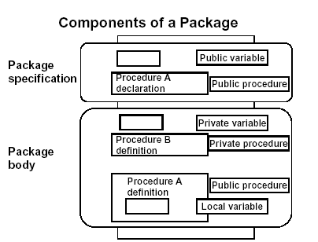
Packages Contd..
Components of a package

Slide 31
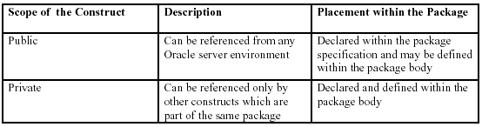
Packages Contd..
A package is created as two parts :
-Specification
-Body
A public package construct is one that is declared in the specification and defined in the package body.
A private package construct is one that is defined solely in the package body.

Slide 32
Packages Contd..
Note:
1.The oracle server stores the package spec and body separately in the database.
2.A package must contain a spec.Having a body is not mandatory.

Slide 33
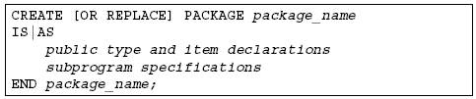
Packages Contd..
Creating a Package Specification
Syntax
The replace option drops and recreates the package specification.
Variables declared in the spec are initialized to NULL by default.

Slide 34
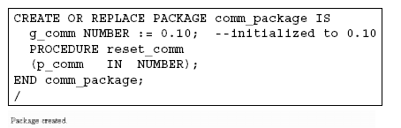
Packages Contd..
Example
G_COMM is a gobal variable and is initialized to 0.10.
RESET_COMM is a public procedure and that is implemented in the package body.

Slide 35
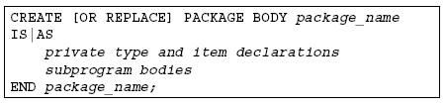
Packages Contd..
Creating a Package Body
Syntax
The replace option drops and recreates the package body.
Identifiers defined only inside the package body are private constructs. They are not visible outside package body.

Slide 36
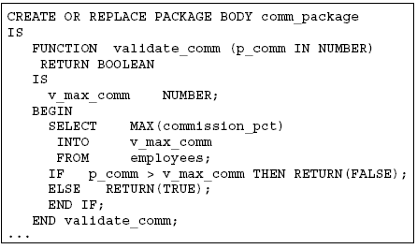
Packages Contd..
Example

Slide 37
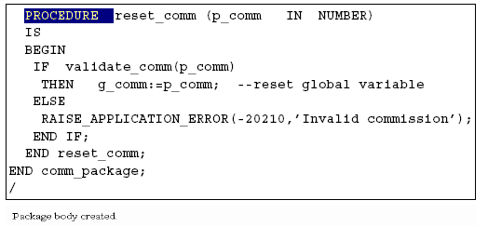
Packages Contd..
Example contd..

Slide 38
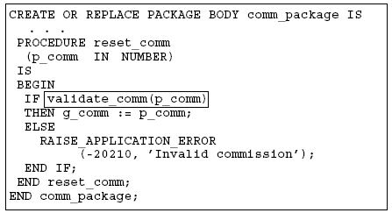
Packages Contd..
Invoking Package constructs
Example 1: Invoke a function from a procedure within the same
package.

Slide 39
Packages Contd..
Example 2: Invoke a package procedure from SQL*Plus
Example 3: Invoke a package procedure from a different schema

Slide 40
Packages Contd..
Removing Packages
To remove the package specification and body,the following is the syntax:

Slide 41
Key Points to Remember
The semicolon (;) at the end of the END statement and the forward slash (/) after it are nexcessary. This follows from the syntax of a PL/SQL block.
Creating a procedure or function is a DDL command, and an implicit COMMIT is performed both before and after the command is executed.
Once created, the procedure or function should normally be dropped and re-created if the code for the procedure or function changes. To avoid two operations of dropping and re-creating, you can specify the OR REPLACE clause when you create the procedure or function, so that the old version of the procedure is overwritten with the new version each time it is created.

Slide 42
Key Points to Remember
While creating a stored procedure,In case of compilation errors, the following message will appear.
Warning: Procedure created with compilation errors.
The corresponding errors can be seen by using the following command
SQL> show errors
The RETURN statement has two general forms:
RETURN;
RETURN expression;
  The first form of the RETURN statement can be used in procedures. It stops the execution of the procedure at that point and transfers control to the calling program. It can't return a value.
  The second form of the RETURN statement is and must be used in functions. It not only transfers control to the calling program, but it also returns a value.

Slide 43


Slide 44
Thank You

